Slide 1
INT 222 ADVANCE WEB DEVELOPMENT
By:Divya Thakur
UID:28300

Slide 2
CONTENTS:
EVENTS
TIMERS
HTTP MODULE
Nodemon

Slide 3
Event Module
If you worked with JavaScript in the browser, you know how much of the interaction of the user is handled through events: mouse clicks, keyboard button presses, reacting to mouse movements, and so on.
On the backend side, Node.js offers us the option to build a similar system using the events module.
This module, in particular, offers the EventEmitter class, which we'll use to handle our events.
This object exposes, among many others, the on and emit methods.
emit is used to trigger an event
on is used to add a callback function that's going to be executed when the event is triggered

Slide 4
Event Module
Much of the Node.js core API is built around an idiomatic asynchronous event-driven architecture in which certain kinds of objects (called "emitters") emit named events that cause Function objects ("listeners") to be called.
Every action on a computer is an event. Like when a connection is made or a file is opened.
Node.js is perfect for event-driven applications.
Node.js has a built-in module, called "Events", where you can create-, fire-, and listen for- your own events.
To include the built-in Events module use the require() method.
var eventEmitter = require('events'); // class
In addition, all event properties and methods are an instance of an EventEmitter object. To be able to access these properties and methods, create an EventEmitter object:
var event = new EventEmitter(); //object

Slide 5
The EventEmitter Object
In Node.js, many core modules inherit the EventEmitter class.
You can assign event handlers to your own events with the EventEmitter object.
All objects that emit events are instances of the EventEmitter class.
The event can be emitted or listen to an event with the help of EventEmitter.
An EventEmitter object has two main functions:
Emit a named event.
Attach and detach one or more event listeners to the named event.

Slide 6
Steps to use event module
1. First, include the events module using the require() function:
const EventEmitter = require('events');
2. The EventEmitter is a class ,create a new instance of the EventEmitter class:
const event = new EventEmitter();
3. Third, attach one or more event handlers to the event by using the on() method:
event.on('saved', ( ) => {
console.log(`A saved event occurred.`);
});

Slide 7
on is used to add a callback function that's going to be executed when the event is triggered
emit is used to trigger an event
In this example, the event name is saved and the event handler is a callback. When the saved event occurs, the callback is invoked automatically.
Finally, trigger the saved event using the emit() method of the EventEmitter object.
event.emit('saved');
The example shows a simple EventEmitter instance with a single listener. The event.on() method is used to register listeners, while the event.emit() method is used to trigger the event.

Slide 8
EXAMPLE
const EventEmitter = require("events");
const event = new EventEmitter();
event.on('save',()=> {
console.log(`A saved event occurred.`);
});
event.emit('save');

Slide 9
Example
You can pass arguments to the event handler by passing them as additional arguments to emit():
eventEmitter.on('start', number => {
console.log(`started ${number}`);
});
eventEmitter.emit('start', 23);
Multiple arguments:
eventEmitter.on('start', (start, end) => {
console.log(`started from ${start} to ${end}`);
});
eventEmitter.emit('start', 1, 100);

Slide 10
The EventEmitter object also exposes several other methods to interact with events, like
once(): add a one-time listener
removeListener() / off(): remove an event listener from an event
removeAllListeners(): remove all listeners for an event

Slide 11
Timers
The Timers module provides a way scheduling functions to be called later at a given time.
The Timer object is a global object in Node.js, and it is not necessary to import it using the require keyword.
The timer module exposes a global API for scheduling functions to be called at some future period of time. Because the timer functions are globals, there is no need to call require('node:timers') to use the API.
The timer functions within Node.js implement a similar API as the timers API provided by Web Browsers but use a different internal implementation that is built around the Node.js Event Loop.

Slide 12
Example
Problem : Write "Hello" every 500 milliseconds:
Solution:
var myInt = setInterval(function () {
console.log("Hello");
}, 500);

Slide 13
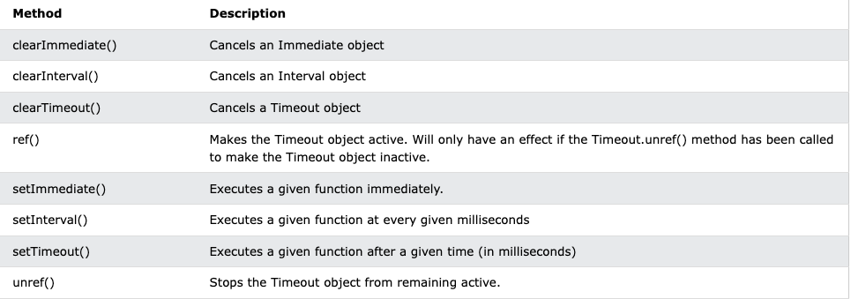
TASK : PERFORM ALL THE BELOW GIVEN TIMERS

Slide 14
HTTP MODULE
WEB SERVER :
A web server is a software program which serves web pages to web users.
To access web pages of any web application, you need a web server to handle all the http request for the web application.
Nodejs provides capabilities to create your own web server which will handle all requests asynchronously .
Node.js has a built-in module called HTTP, which allows Node.js to transfer data over the Hyper Text Transfer Protocol (HTTP).

Slide 15
The HTTP module can create an HTTP server that listens to server ports and gives a response back to the client.
To include the HTTP module, use the require() method:
const http=require(“http”);

Slide 16
HTTP Methods
1. createServer() : create an HTTP server
The http. createServer() method creates an HTTP Server object.
The HTTP Server object can listen to ports o your computer and execute a function, a requestListener, each time a request is made.
2. response.end() : This method signals to the server that all of the response headers and body have been sent; that server should consider this message complete.
3. Server.listen() : The server. listen() method creates a listener on the specified port or path.

Slide 17
Program to create server
const http=require("http");
const server=http.createServer((req,res)=>{
res.end("hello i am a response");
});
server.listen(1000 ,()=>{
console.log("listening to port number 1000")
});

Slide 18
Using URL
The url module provides utilities for URL resolution and parsing. It can be accessed using:
var url = require('url');
1. to get the url accessed :
console.log(req.url);
Going to fetch the urls that you try to access with server .

Slide 19
Handle Http Request (Routing)
var http = require('http');
var server = http.createServer(function (req, res) {
if (req.url == '/') {
res.end('Welcome to Index page');
}
else if (req.url == "/emp") {
res.end('Welcome to Employees page');
}
else
{
res.end("invalid request of the user");
}
});
server.listen(1000);
console.log('Server is running at port 1000')

Slide 20
Task
Create three different Html Files ,add different content in the files. Create http request to access data of these files by their url via server on the browser(ROUTING) .If the url doesnot exist then “404 ERROR NOT FOUND” should be printed on the browser.

Slide 21
nodemon
nodemon is a tool that helps develop Node.js based applications by automatically restarting the node application when file changes in the directory are detected.
nodemon does not require any additional changes to your code or method of development. nodemon is a replacement wrapper for node. To use nodemon, replace the word node on the command line when executing your script.
Install Nodemon Globally :
npm install -g nodemon

